Slide 1
CA1 Assignment 1(DSAA) By: Loh Yip Khai p2317454 DAAA/FT/2A/03

Slide 2
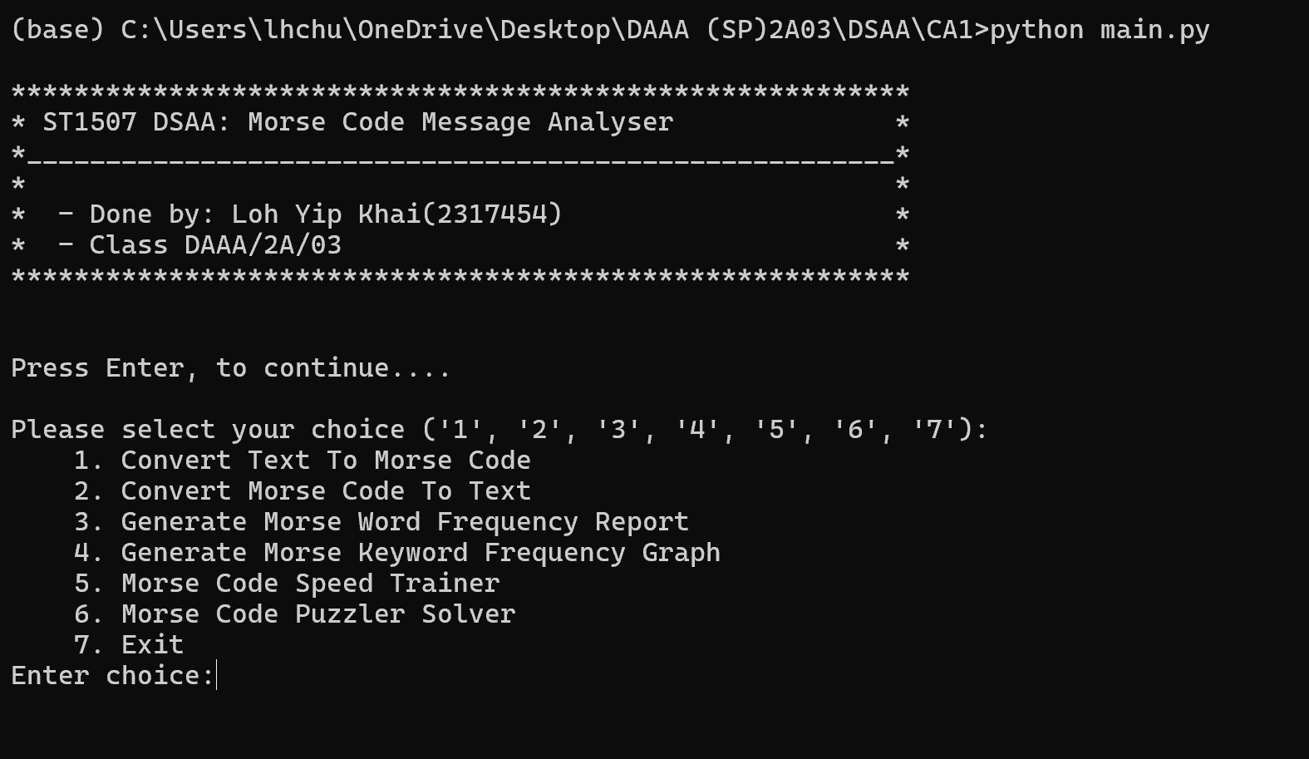
User Guidelines
The Morse Code Message Analyzer is a Python app for text-to-Morse, Morse-to-text conversion, frequency reports, keyword graphs, speed training, and puzzle solving.
Starting the Application: Run the Python script python Main.py to start the application.
Main Menu: Upon starting, you'll see the main menu with options to perform various tasks related to Morse code.
Options:
1. Convert Text To Morse Code: Convert plain text to Morse code.
2. Convert Morse Code To Text: Convert Morse code to plain text.
3. Generate Morse Word Frequency Report: Generate a report showing the frequency of words in Morse code.
4. Generate Morse Keyword Frequency Graph: Generate a graph displaying the frequency of Morse code keywords.
5. Morse Code Speed Trainer: Train your Morse code speed with interactive exercises.
6. Morse Code Puzzle Solver: Solve Morse code puzzles.
7. Exit: Exit the application.

Slide 3
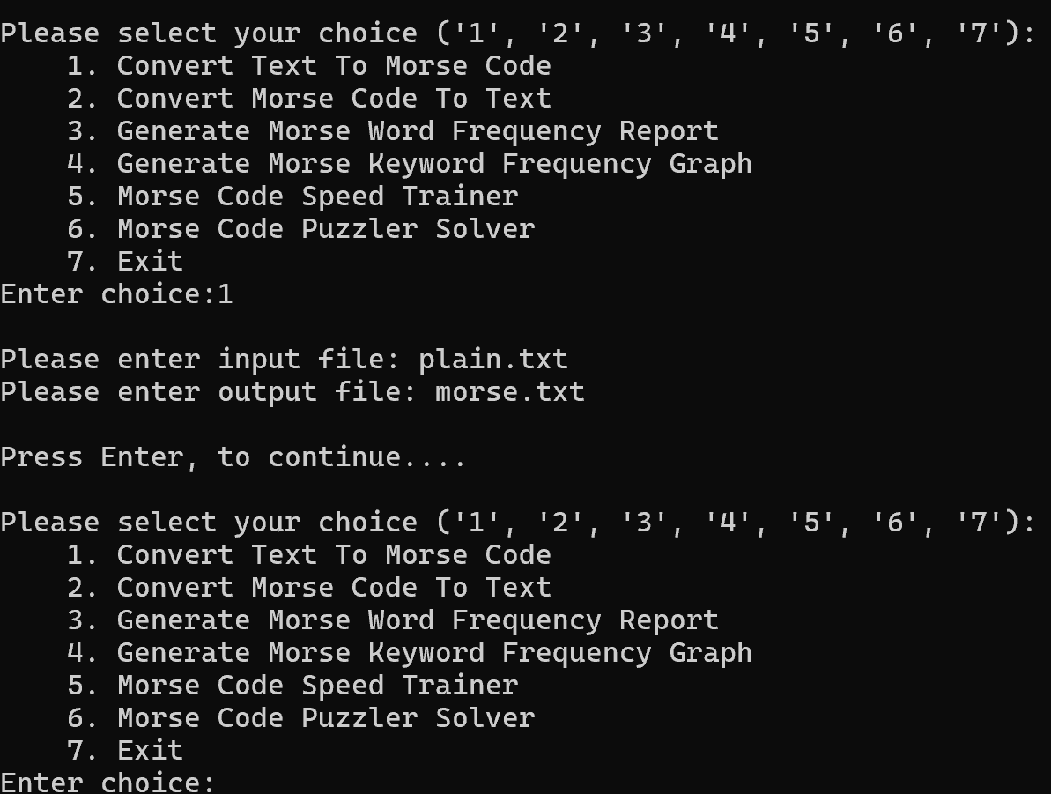
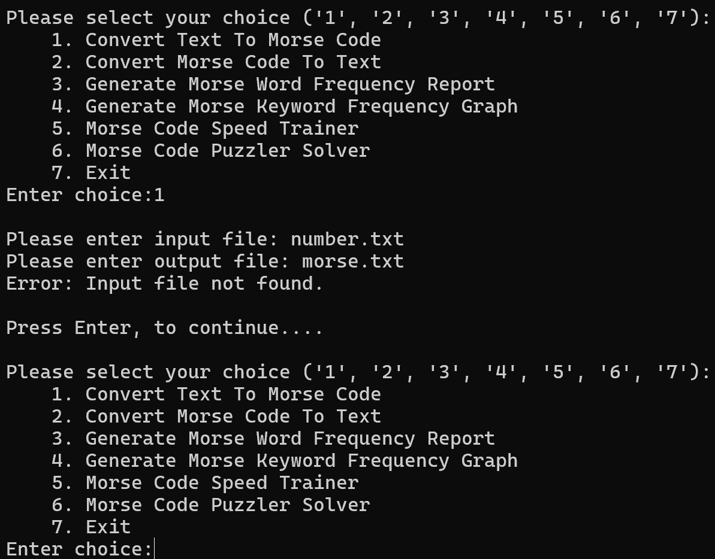
User Guidelines
Input and Output Files:
For options 1 to 4, you'll be prompted to enter input and output file paths.
Ensure that input files exist and have the necessary permissions.
Output files will be created or overwritten as needed
Error Handling:
If an input file is not found, an error message will be displayed, and you'll return to the main menu.

Slide 4
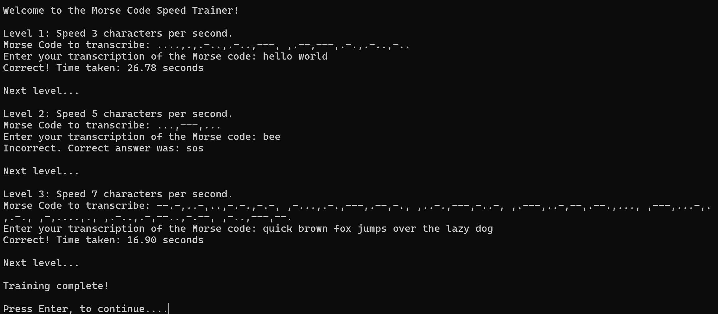
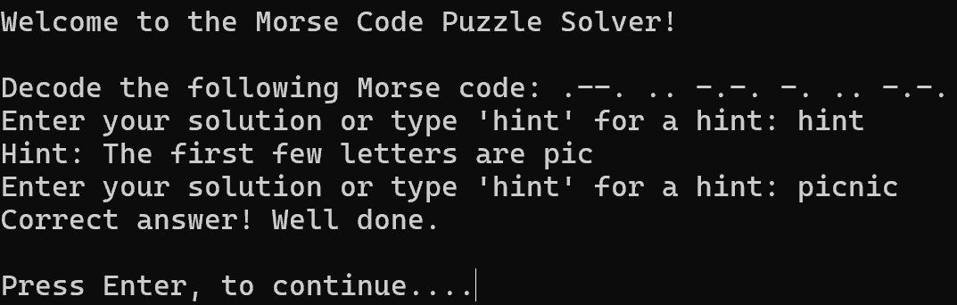
User Guidelines
Speed Trainer:
Use the speed trainer to practice your Morse code skills and improve your speed and accuracy.
Puzzle Solver:
Solve Morse code puzzles presented by the application.
Enter your solution or request a hint if needed

Slide 5
Classes Developed
Morse_Code_Main: Acts as the main controller class. Manages the interaction with the user through a menu system. Handles the execution of various tasks like converting text to Morse code, generating frequency reports, etc.
Morse_Code_Converter: Converts text to Morse code and vice versa. Utilizes dictionaries to map characters to their Morse code equivalents. Implements methods for text-to-Morse and Morse-to-text conversions.
FrequencyAnalyzer: Analyzes the frequency of words in Morse code. Generates reports and graphs based on the frequency analysis. Utilizes the Counter class from the collections module for frequency counting.
MorseCodeSpeedTrainer: Provides functionality for training Morse code speed. Implements a speed training system with different levels of difficulty. Measures user response time and provides feedback on correctness.
MorseCodePuzzle and SimpleDecodePuzzle: Abstract base class for Morse code puzzles and a concrete implementation for simple decoding puzzles. Allows for the creation of various puzzle types by subclassing and implementing necessary methods.
PuzzleManager: Manages the selection and solving of Morse code puzzles. Provides methods for selecting puzzles, checking answers, and giving hints.

Slide 6
OOP Concepts used
Encapsulation: The Morse_Code_Main class encapsulates the program's core functionalities, like user interaction and task execution, such as converting text to Morse code and generating frequency reports. Private attributes like _converter, _analyzer, _speed_trainer, and _puzzle_manager encapsulate instances of other classes, enabling Morse_Code_Main to use their functionality without revealing internal details to external code.
Inheritance: SimpleDecodePuzzle inherits from MorseCodePuzzle, demonstrating inheritance where subclasses inherit methods and attributes from their superclass.
Polymorphism: Polymorphism is exhibited through method overriding. For example, check_answer() and give_hint() methods are overridden in the SimpleDecodePuzzle class.
Abstraction: Abstract classes like MorseCodePuzzle provide a blueprint for puzzle types without implementation details. Concrete subclasses then implement specific puzzle types.

Slide 7
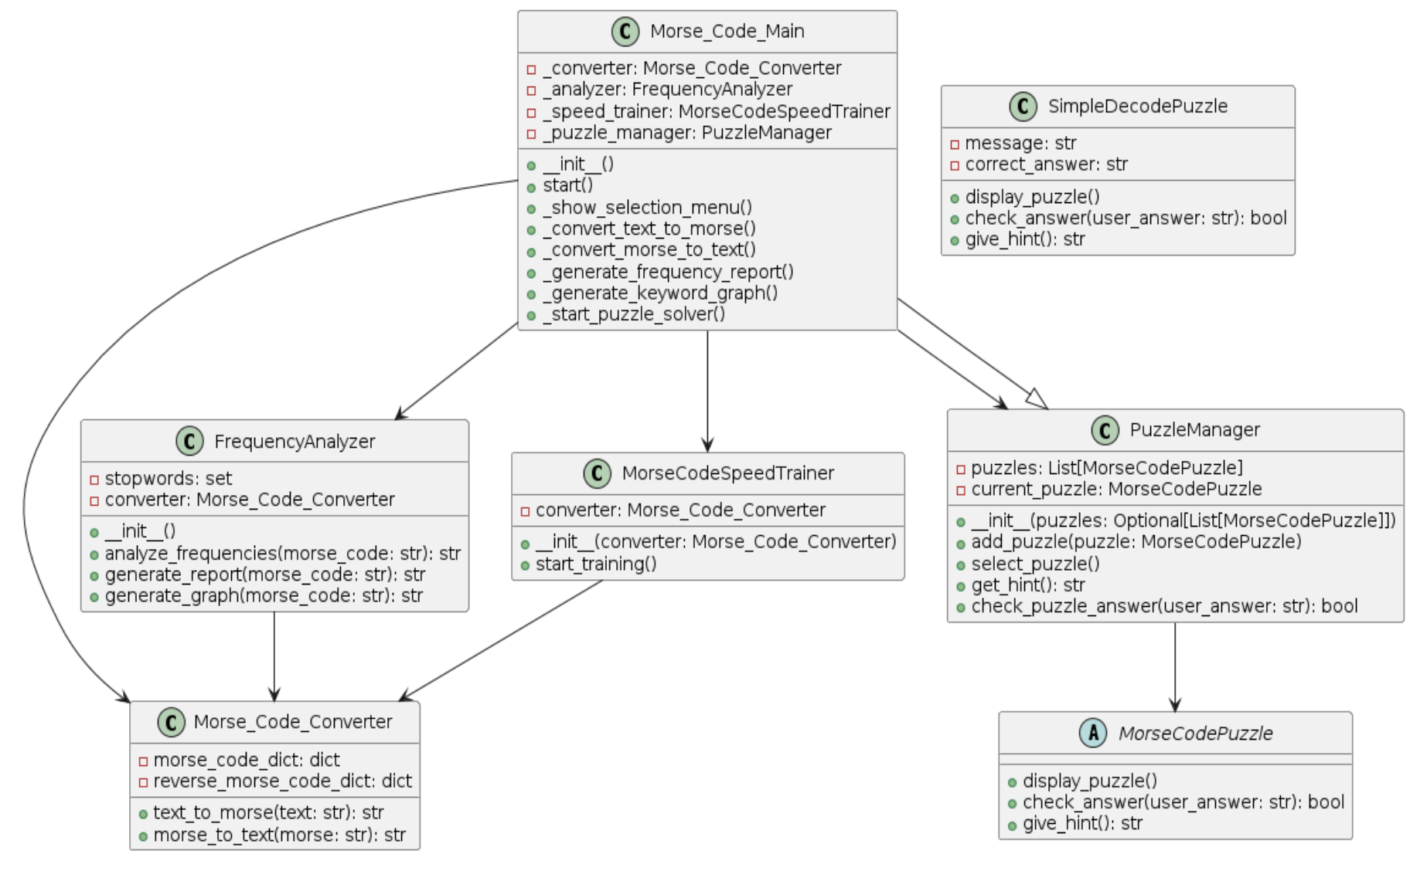
Class Diagram

Slide 8
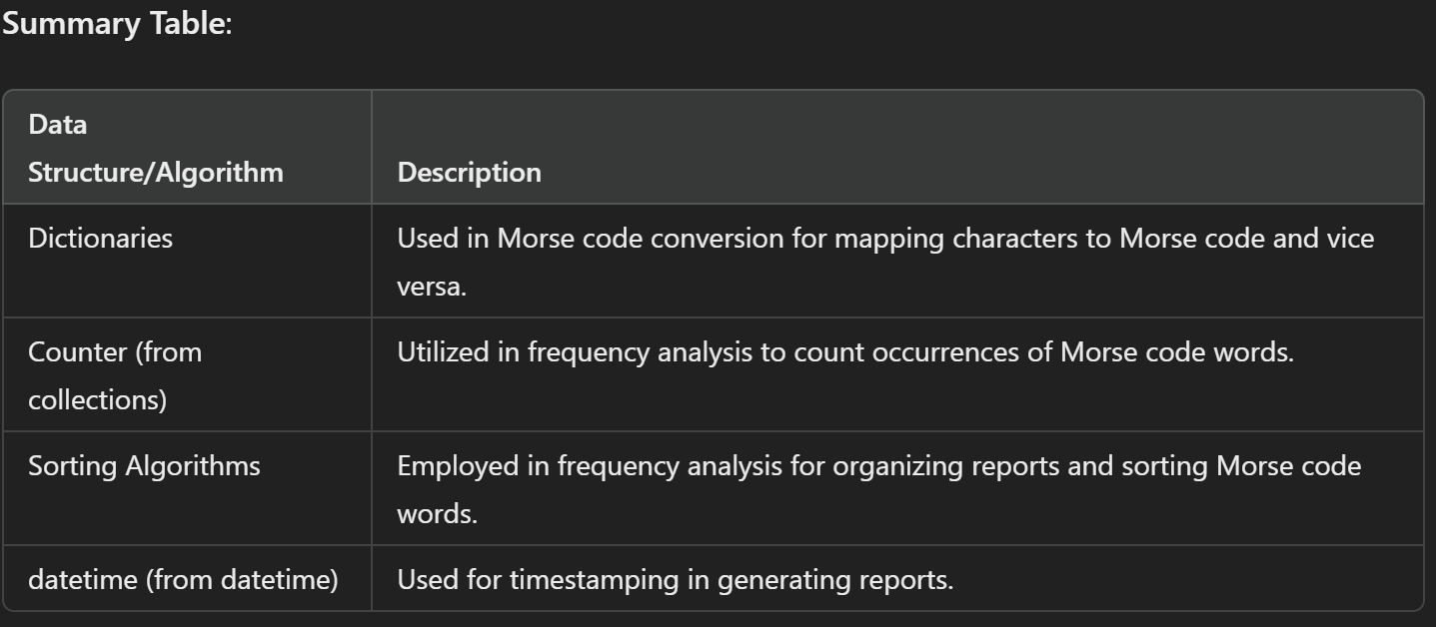
Data Structures and Algorithms
Morse_Code_Converter:
Data Structures: Uses dictionaries (morse_code_dict and reverse_morse_code_dict) to map characters to Morse code and vice versa.
Algorithms:
text_to_morse: Converts text to Morse code by iterating through each character and looking up its Morse code representation in the dictionary.
morse_to_text: Converts Morse code to text by reversing the process, looking up Morse code sequences and mapping them back to characters.
FrequencyAnalyzer:
Data Structures: Utilizes Python Counter to count frequencies of Morse code words.
Algorithms:
analyze_frequencies: Analyzes the frequencies of Morse words and generates a report. Utilizes dictionaries and sorting algorithms to organize the report.
generate_report: Generates a report including decoded Morse text, timestamp, and frequency analysis. Utilizes datetime for timestamping.
generate_graph: Generates a graphical representation of Morse keyword frequencies. Utilizes Counter for frequency counting and various algorithms to format the graph.
MorseCodeSpeedTrainer:
Data Structures: No specific data structures used.
Algorithms: Implements a speed training algorithm that presents Morse code phrases of increasing difficulty/speed to the user, timing their responses and providing feedback.
MorseCodePuzzleSolver:
Data Structures: No specific data structures used.
Algorithms: Implements puzzle-solving algorithms including displaying puzzles, checking answers, and providing hints.

Slide 9
Summary
While developing the Morse code message analyzer application, challenges included:
1. **Design Complexity:** Balancing responsibilities and interactions among multiple components.
2. **File Handling:** Managing file input/output operations and handling errors effectively.
3. **User Interface:** Designing an intuitive command-line interface with clear instructions.
4. **Algorithm Development:** Creating robust algorithms for Morse code conversion and frequency analysis.
Key takeaways and learning achievements:
1. **Object-Oriented Design:** Mastering class responsibilities, encapsulation, and abstraction.
2. **File Handling:** Improving skills in file input/output operations and error management.
3. **Algorithm Development:** Enhancing algorithmic proficiency in Morse code processing.
4. **User Interface Design:** Learning principles of user-friendly command-line interface design.

Slide 10
Appendix(Source Code)
main.py
from morse_code_main import Morse_Code_Main
main = Morse_Code_Main()
main.start()

Slide 11
Appendix(Source Code)
morse_code_main.py
from morse_code_converter import Morse_Code_Converter
from frequency_analyser import FrequencyAnalyzer
from morse_code_speed_trainer import MorseCodeSpeedTrainer
from morse_code_puzzle_solver import PuzzleManager, SimpleDecodePuzzle
class Morse_Code_Main:
def __init__(self):
self._converter = Morse_Code_Converter()
self._analyzer = FrequencyAnalyzer()
self._speed_trainer = MorseCodeSpeedTrainer(self._converter)
self._puzzle_manager = PuzzleManager([
SimpleDecodePuzzle("-- .- -. -.-", "tank"),
SimpleDecodePuzzle(".--. .. -.-. -. .. -.-.", "picnic")
])
def start(self):
infoText = ""
infoText += '\n' + '*' * 57
infoText += '\n' + '* ' + "ST1507 DSAA: Morse Code Message Analyser" + (' ' * 14) + '*'
infoText += '\n' + '*' + '_' * 55 + '*'
infoText += '\n' + '*' + ' ' * 55 + '*'
infoText += '\n' + '* ' + "- Done by: Loh Yip Khai(2317454)" + (' ' * 21) + '*'
infoText += '\n' + '* ' + "- Class DAAA/2A/03" + (' ' * 35) + '*'
infoText += '\n' + '*' * 57
infoText += '\n' * 3 + "Press Enter, to continue...."
print(infoText)
while True:
if not self._show_selection_menu(): #if return false, aka choice == 7, break out of loop
break
def _show_selection_menu(self):
choiceList = ["Convert Text To Morse Code", "Convert Morse Code To Text", "Generate Morse Word Frequency Report",
"Generate Morse Keyword Frequency Graph", "Morse Code Speed Trainer", "Morse Code Puzzler Solver", "Exit"]
selectionText = ""
selectionText += '\n' + "Please select your choice ('1', '2', '3', '4', '5', '6', '7'):"
for i in range(len(choiceList)):
selectionText += '\n'
selectionText += f" {i + 1}. {choiceList[i]}"
selectionText += '\n' + "Enter choice:"
choice = input(selectionText)
if choice == '1':
self._convert_text_to_morse()
elif choice == '2':
self._convert_morse_to_text()
elif choice == '3':
self._generate_frequency_report()
elif choice == '4':
self._generate_keyword_graph()
elif choice == '5':
self._speed_trainer.start_training()
elif choice == '6':
self._start_puzzle_solver()
elif choice == '7':
print("\n\nBye, thanks for using ST1507 DSAA: MorseCode Message Analyser")
return False
else:
print('Invalid input! Please try again')
input("\nPress Enter, to continue....")
return True
def _convert_text_to_morse(self):
input_file = input('\n'+ "Please enter input file: ")
output_file = input("Please enter output file: ")
try:
with open(input_file, 'r') as f:
text = f.read()
except FileNotFoundError:
print("Error: Input file not found.")
return
morse_code = self._converter.text_to_morse(text)
with open(output_file, 'w') as f:
f.write(morse_code)
# print(f"Text to Morse Code conversion complete. Output written to {output_file}")
def _convert_morse_to_text(self):
input_file = input('\n'+ "Please enter input file: ")
output_file = input("Please enter output file: ")
try:
with open(input_file, 'r') as f:
morse_code = f.read()
except FileNotFoundError:
print("Error: Input file not found.")
return
text = self._converter.morse_to_text(morse_code)
with open(output_file, 'w') as f:
f.write(text)
# print(f"Morse Code to Text conversion complete. Output written to {output_file}")
def _generate_frequency_report(self):
input_file = input("\nPlease enter input file: ")
output_file = input("Please enter output file: ")
try:
with open(input_file, 'r') as f:
morse_code = f.read()
except FileNotFoundError:
print("Error: Input file not found.")
return
report = self._analyzer.generate_report(morse_code)
with open(output_file, 'w') as f:
f.write(report)
# print(f"Morse Word Frequency Report generated. Output written to {output_file}")
def _generate_keyword_graph(self):
input_file = input("\nPlease enter input file: ")
output_file = input("Please enter output file: ")
try:
with open(input_file, 'r') as f:
morse_code = f.read()
except FileNotFoundError:
print("Error: Input file not found.")
return
graph = self._analyzer.generate_graph(morse_code)
with open(output_file, 'w') as f:
f.write(graph)
# print(f"Morse Keyword Frequency Graph generated. Output written to {output_file}")
def _start_puzzle_solver(self):
print("Welcome to the Morse Code Puzzle Solver!\n")
self._puzzle_manager.select_puzzle()
while True:
user_input = input("Enter your solution or type 'hint' for a hint: ")
if user_input.lower() == 'hint':
print(self._puzzle_manager.get_hint())
elif self._puzzle_manager.check_puzzle_answer(user_input):
print("Correct answer! Well done.")
break
else:
print("That's not correct. Try again or type 'hint' for a hint.")

Slide 12
Appendix(Source Code)
morse_code_converter.py
class Morse_Code_Converter:
morse_code_dict = {
'A': '.-', 'B': '-...', 'C': '-.-.', 'D': '-..', 'E': '.', 'F': '..-.',
'G': '--.', 'H': '....', 'I': '..', 'J': '.---', 'K': '-.-', 'L': '.-..',
'M': '--', 'N': '-.', 'O': '---', 'P': '.--.', 'Q': '--.-', 'R': '.-.',
'S': '...', 'T': '-', 'U': '..-', 'V': '...-', 'W': '.--', 'X': '-..-',
'Y': '-.--', 'Z': '--..', '1': '.----', '2': '..---', '3': '...--',
'4': '....-', '5': '.....', '6': '-....', '7': '--...', '8': '---..',
'9': '----.', '0': '-----',
}
reverse_morse_code_dict = {v: k for k, v in morse_code_dict.items()}
def text_to_morse(self, text):
morse_code = []
for line in text.splitlines(): # Split the text into lines
morse_line = []
for word in line.split(' '): # Separate words into a list by ' '
morse_word = ','.join(self.morse_code_dict.get(char.upper(), '') for char in word) # Convert each char into morse, joined by ','
morse_line.append(morse_word)
morse_code.append(', ,'.join(morse_line))
return '\n'.join(morse_code) # Join the lines with newline character
def morse_to_text(self, morse):
text = []
for morse_line in morse.split('\n'): # Split the morse code into lines
line = []
for morse_word in morse_line.split(', ,'):
word = ''.join(self.reverse_morse_code_dict.get(code, '') for code in morse_word.split(','))
line.append(word)
text.append(' '.join(line))
return '\n'.join(text) # Join the lines with newline character

Slide 13
Appendix(Source Code)
frequency_analyser.py
from collections import Counter
from morse_code_converter import Morse_Code_Converter
import datetime
class FrequencyAnalyzer:
def __init__(self):
self.stopwords = set()
with open('stopwords.txt', 'r') as f:
stopwords = f.read().splitlines()
self.stopwords = set(word.upper() for word in stopwords)
self.converter = Morse_Code_Converter()
def analyze_frequencies(self, morse_code):
plain_text = self.converter.morse_to_text(morse_code)
words = plain_text.upper().split()
freq = Counter(words)
keywords = {word: count for word, count in freq.items()}
report = ''
distinct_counts = []
for count in keywords.values():
if count not in distinct_counts:
#storing distinct counts(frequencies)
distinct_counts.append(count)
distinct_counts.sort()
# Summary of Morse words grouped, and sorted by frequencies
for count in distinct_counts:
report += f"*** Morse Words with frequency => {count}\n"
temp_keywords = {word: count_word for word, count_word in keywords.items() if count_word == count}
# Sort words by Morse code length desc, and sort words with the same length by alphabetical order
sorted_keywords = sorted(temp_keywords.items(), key=lambda x: (-len(self.converter.text_to_morse(x[0])), x[0]))
for word, count in sorted_keywords:
morse_word = self.converter.text_to_morse(word)
if word not in self.stopwords:
report += f"[{morse_word}]=> {word}(*)\n"
else:
report += f"[{morse_word}]=> {word}\n"
report += '\n'
#List of keywords sorted by frequencies
distinct_counts.sort(reverse= True)
report += f"*** Keywords sorted by Frequency\n"
#sort words by freq desc
for count in distinct_counts:
temp_keywords = {word: count_word for word, count_word in keywords.items() if count_word == count}
#sort words with same frequency by alphabetical order
sorted_keywords = sorted(temp_keywords.items(), key=lambda x: (x[0]))
for word, count in sorted_keywords:
#check if word is not a stopword
if word not in self.stopwords:
report += f"{word}({count})\n"
return report
def generate_report(self, morse_code):
plain_text = self.converter.morse_to_text(morse_code)
#Time stamp indicating the date and time that the report was generated
timestamp = datetime.datetime.now().strftime("%Y-%m-%d %H:%M:%S")
report = f"**********************************************\n"
report += f" REPORT GENERATED ON: {timestamp}\n"
report += f"**********************************************\n\n"
#Decoded morse text
report += f"*** Decoded Morse Text\n{plain_text}\n\n"
report += self.analyze_frequencies(morse_code)
return report
def generate_graph(self, morse_code):
# Time stamp indicating the date and time that the report was generated
timestamp = datetime.datetime.now().strftime("%Y-%m-%d %H:%M:%S")
report = f"***********************************************************\n"
report += f" REPORT GENERATED ON: {timestamp}\n"
report += f"***********************************************************\n\n"
plain_text = self.converter.morse_to_text(morse_code)
words = plain_text.upper().split()
freq = Counter(words)
keywords = {word: count for word, count in freq.items()}
distinct_counts = []
for count in keywords.values():
if count not in distinct_counts:
# storing distinct counts(frequencies)
distinct_counts.append(count)
distinct_counts.sort(reverse=True)
bar_list = []
morse_list = []
plain_text_list = []
# List of keywords sorted by frequencies
for count in distinct_counts:
temp_keywords = {word: count_word for word, count_word in keywords.items() if count_word == count}
# sort words by length desc, and sort words with same length by alphabetical order
sorted_keywords = sorted(temp_keywords.items(), key=lambda x: (x[0]))
for word, count in sorted_keywords:
# check if word is not a stopword
if word not in self.stopwords:
temp_bar = ""
for i in range(count):
temp_bar += '*' + '\n'
bar_list.append(temp_bar.rstrip('\n'))
# Get Morse code for the word
morse_code_word = self.converter.text_to_morse(word)
morse_list.append(morse_code_word)
plain_text_list.append(word)
# Determine the maximum height of the bars
max_height = max(len(bar.split('\n')) for bar in bar_list)
# Adjust each bar to be of equal height by padding with spaces at the top as necessary
adjusted_bars = []
for bar in bar_list:
lines = bar.split('\n')
padded_bar = [' '] * (max_height - len(lines)) + lines
adjusted_bars.append(padded_bar)
# Concatenate the bars side-by-side with a leading space and 9 spaces between bars
combined_lines = []
for i in range(max_height):
combined_line = ' ' + ' '.join(bar[i] for bar in adjusted_bars)
combined_lines.append(combined_line)
for line in combined_lines:
report += line + '\n'
report += 59 * '_' + '\n'
# Prepare vertical Morse and plain text side-by-side
morse_plain_combined = []
max_morse_plain_height = max(len(morse) for morse in morse_list)
# Adjust Morse and plain text lists to match the maximum height
for i in range(len(morse_list)):
morse = morse_list[i]
plain_text = plain_text_list[i]
padded_morse = list(morse) + [' '] * (max_morse_plain_height - len(morse))
padded_plain_text = list(plain_text) + [' '] * (max_morse_plain_height - len(plain_text))
combined_morse_plain = [morse_char + ' ' + plain_char for morse_char, plain_char in zip(padded_morse, padded_plain_text)]
morse_plain_combined.append(combined_morse_plain)
# Concatenate the morse code and plain text columns side-by-side with 8 spaces between each pair
for i in range(max_morse_plain_height):
combined_line = ' ' + ' '.join(morse_plain_combined[j][i] for j in range(len(morse_plain_combined)))
report += combined_line + '\n'
return report

Slide 14
Appendix(Source Code)
morse_code_speed_trainer.py
import time
class MorseCodeSpeedTrainer:
def __init__(self, converter):
self.converter = converter
def start_training(self):
levels = [
{'speed': 3, 'text': "hello world"},
{'speed': 5, 'text': "sos"},
{'speed': 7, 'text': "quick brown fox jumps over the lazy dog"}
]
print("\nWelcome to the Morse Code Speed Trainer!\n")
for level in levels:
#speed rate that the user should be able to recognize and transcribe the Morse code
print(f"Level {levels.index(level) + 1}: Speed {level['speed']} characters per second.")
morse_code = self.converter.text_to_morse(level['text'])
print(f"Morse Code to transcribe: {morse_code}")
start_time = time.time()
user_input = input("Enter your transcription of the Morse code: ")
duration = time.time() - start_time
correct = user_input.lower().replace(" ", "") == level['text'].replace(" ", "")
if correct:
print(f"Correct! Time taken: {duration:.2f} seconds")
else:
print("Incorrect. Correct answer was:", level['text'])
print("\nNext level...\n")
print("Training complete!")

Slide 15
Appendix(Source Code)
morse_code_puzzle_solver.py
from abc import ABC, abstractmethod
import random
class MorseCodePuzzle(ABC):
@abstractmethod
def display_puzzle(self):
pass
@abstractmethod
def check_answer(self, user_answer):
return False
@abstractmethod
def give_hint(self):
pass
class SimpleDecodePuzzle(MorseCodePuzzle):
def __init__(self, message, correct_answer):
self.message = message
self.correct_answer = correct_answer
def display_puzzle(self):
print(f"Decode the following Morse code: {self.message}")
def check_answer(self, user_answer):
return user_answer.lower() == self.correct_answer.lower()
def give_hint(self):
# Provide a part of the answer
return f"Hint: The first few letters are {self.correct_answer[:len(self.correct_answer) // 2]}"
class PuzzleManager:
def __init__(self, puzzles=None):
self.puzzles = puzzles if puzzles else []
self.current_puzzle = None
def add_puzzle(self, puzzle):
self.puzzles.append(puzzle)
def select_puzzle(self):
if self.puzzles:
self.current_puzzle = random.choice(self.puzzles)
self.current_puzzle.display_puzzle()
def get_hint(self):
if self.current_puzzle:
return self.current_puzzle.give_hint()
def check_puzzle_answer(self, user_answer):
if self.current_puzzle:
return self.current_puzzle.check_answer(user_answer)
return False

